Slide 1
Artificial Intelligence
Prepared by:

Slide 2
What is Artificial intelligence?

Slide 3
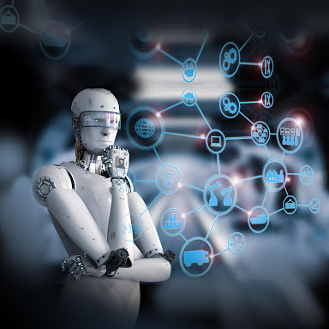
The ability of digital machines and computers to perform certain tasks that mimic And similar to that carried out by intelligent beings,

Slide 4
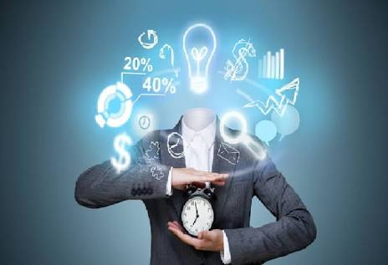
Artificial intelligence abilities!

Slide 5
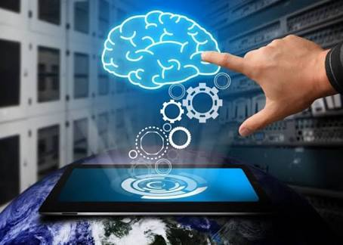
sense
The ability to sense, correlates directly with object recognition. In this case, object recognition is the picking out and identification of objects from different inputs such as videos and digital images.natural Language Processing (NLP) also contributes to the ability to sense, meaning the ability to read text and make ense of it.

Slide 6
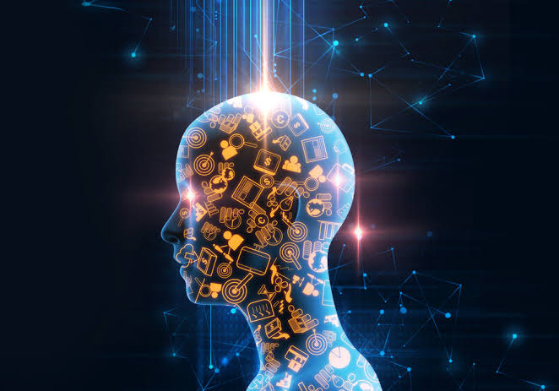
conversation
The second, which is the ability to have a conversation, is the foundation to develop the ability to think.
PredictiveAnalytics sums this up by identifying the likelihood of future outcomes based on historical data and algorithms(machine learning).

Slide 7
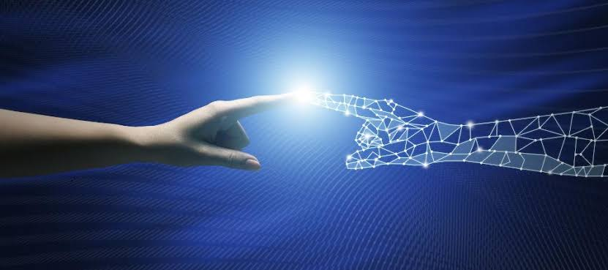
The third, the ability to act, refers to taking action based on thinking. This is also known as Prescriptive Analytics, and determines the best solutions/outcomes among various choices, with known parameters.
Acting

Slide 8
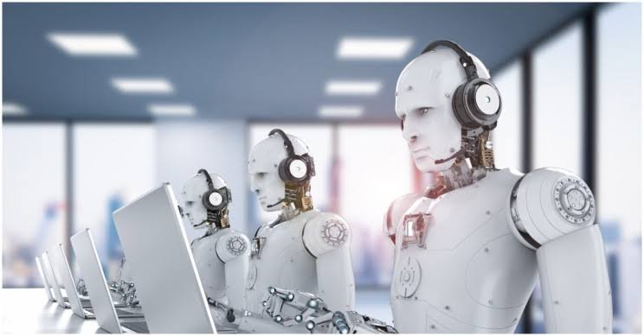
learning
The fourth and final ability, the ability to learn, includes automatically occurring selfimprovements. Not only do these improvements need to happen, but we also need to understand how these improvements were made as they occur.

Slide 9
Artificial intelligence applications
The field of agriculture:
AI is used in monitoring the weather conditions to know the most appropriate times for cultivation.
medicine field:
AI has helped to achieve greater accuracy, especially in diagnosing diseases and determining appropriate treatments based on the type of disease with high accuracy.
The recruitment operations field:
AI makes it easier to screen applicants for a specific job and read their CVs to identify competencies.

Slide 10
Artificial intelligence and the future
Scientists and researchers are working to develop future artificial intelligence in a way that can be greatly beneficial and in various aspects of life; from smartphones, to cars, or even homes that run on the smart system, security system, medical care, and many others.

