Slide 1

Burns & its First Aids
Prepared by: mohannad mohsen dugdugi
ID: 201803726
6th level
Emergency medical services
Jazn university
Dr : Hamood mohamed yahya Alsariha

Slide 2
Burns definition
It is the exposure of the skin to one of the heat-transmitting factors, which the skin can tolerate to a certain degree after which its cells begin to deteriorate, as a result of the erosion of one of the layers of the skin such as the epidermis, the dermis, or the sub-dermis layer, resulting in redness and abrasion that leaves annoying effects while After, the burns vary according to the area covered between minor burns and severe burns.

Slide 3
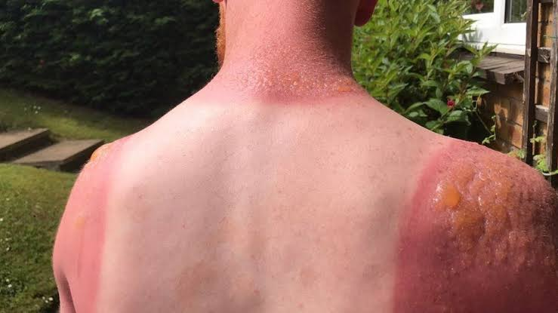
The factors causing skin burns
when exposed to ultraviolet sunlight for long periods, as the heat resulting from these rays causes surface burns of the first degree and second degree.
1.The skin is exposed to the sun
Treatment: use cold water and add
Moisturizing creams and antibiotics to facilitate treatment quickly

Slide 4
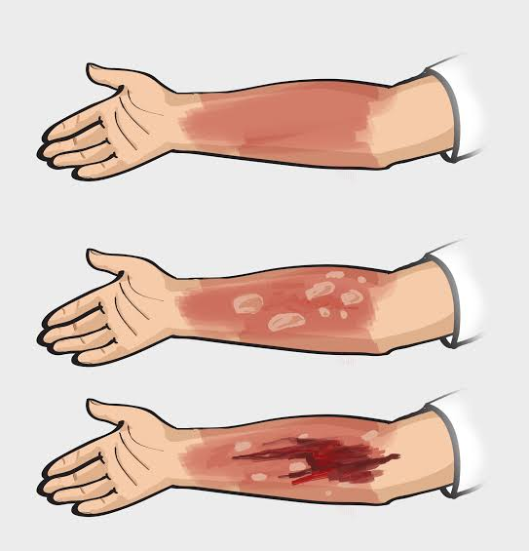
The factors causing skin burns
2.Inflamed fire
It is one of the most common causes of burns, usually as a result of a fire in the place, a cylinder of gas, or a house furniture fire with cigarette residues.
Treatment: use cold water and add
Moisturizing creams and antibiotics for recovery quickly

Slide 5
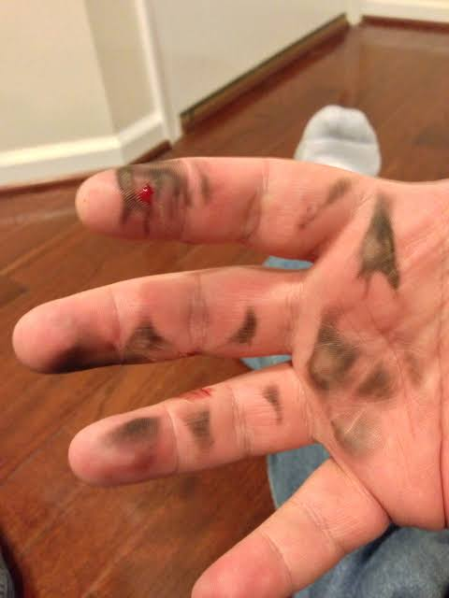
The factors causing skin burns
The body is affected by electric shock directly, where the greater the resistance of tissues to the intensity of the electrical current, the greater the severity of the burn, and the effect on the muscles is greater than the effect on the visible skin.
Treatment :
turn off elctricity,
prevent the infected person from being cold.
cover any burned areas with a sterile gauze bandage, or with a clean piece of cloth, in this case we do not use a blanket or towel because the fibers may stick to the burns.
3.Electrical stun

Slide 6
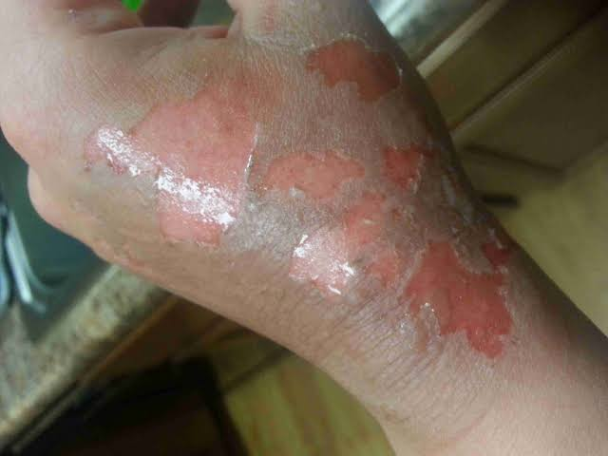
The factors causing skin burns
the skin endures the water temperature up to 40 ° C, and when it rises above this limit it causes cell damage, and water bags appear on the skin.
4. Hot water
Treatment : add cold water and can also apply a good moizturing cream.

Slide 7
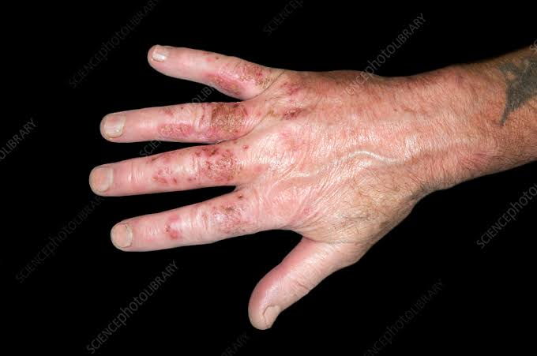
The factors causing skin burns
We often use cleaning agents that contain acid and alkaline chemicals, and when the skin is exposed to these substances excessively or wrongly, it becomes severely burned.
5.chemicals
wash the chemical from the skin with running cold water for at least 10 minutes.
cover the burn with a sterile gauze piece and do not use cotton, or with a clean cloth we wrap it loosely to avoid applying pressure to the burned skin.

Slide 8
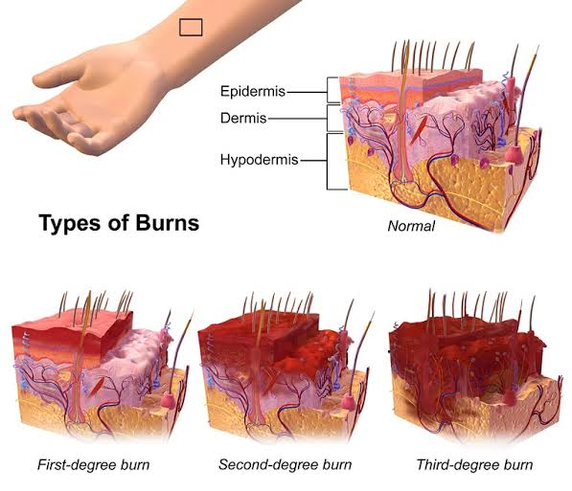
Types of burns and methods of treatment
burns of the first degree
This type of burn affects the surface layer of the skin (the epidermis), and is affected by exposure to hot sunlight for a long time, and treatment is as follows:
clean the affected area with cold water, and sterile disinfectant.
Apply topical ointment on the area containing an antibiotic.
Treating second degree burns
in this type of burn exceeds the infection of the epidermis, and its effect reaches a part of the dermis layer, and therefore damage occurs in parts of the nerve endings causing great pain, and its treatment is as follows:
Clean the area with a sterile solution.
Apply sterile dressings, and change them daily.
Use antibiotics to prevent the multiplication of bacteria that lead to skin inflammation.

Slide 9
The effects and complications
resulting from the burns are complete deformation in the external appearance of the body, due to the random healing of the burns, the lack of normal skin cells to reproduce, and thus heal by making fibrous tissues that are very different from the normal skin and which cannot perform its functions.
A negative impact on the psyche of the injured person due to the deformity that affected him, as this causes him to withdraw and isolate from people.
Burned parts lose their natural elasticity.
Exposure to the area affected by bacterial infections as a result of exposure to the inner layer of the skin, and weak resistance to the body as a result of burning these bacteria.
3.Treatment of third degree burns
Burns of this degree are deep as they destroy all layers of the skin including hair follicles, muscles, nerves, and all of its glands and cells, these burns are very painful, and treatment is As follows:
take pain relievers.
Using topical antibiotics, and replacing lost fluids in the central care unit.
Surgery to patch the affected area.

Slide 10
References
1.Hettiaratchy S, Dziewulski P (2004) ABC of burns: pathophysiology and
types of burns. BMJ 328:1427-1429.
2. Peck MD (2012) Epidemiology of burns throughout the World. Part II:
Intentional burns in adults. Burns 38: 630-637.
3. Moctezuma-Paz L, Páez-Franco I, Jimenez-González S, Miguel-James
KD, Fonserrada-Ortega G, et al. (2015) Epidemiology of burns in Mexico.
Rev Esp Méd Quir. 20: 78-82.
4. Jackson DM (1953) Нe diagnosis of the depth of burning. Br J Surg 40:
588-596.
5. Jose RM, Roy DK, Vidyadharan R, Erdmann M (2004) Burns area
estimation-an error perpetuated. Burns 30: 481-482.
6. Spanholtz TA, Нeodorou P, Amini P, Spilker G (2009) Severe burn
injuries acute and long-term treatment. Dtsch Arztebl Int 106: 607-613.

Slide 11


